Slide 1

Cardiovascular Disease Surveillance
Fleetwood Loustalot, PhD, FNP, FAHA
CAPT, US Public Health Service
Division for Heart Disease and Stroke Prevention National Center for Chronic Disease Prevention and Health Promotion Centers for Disease Control and Prevention
National Center for Chronic Disease Prevention and Health Promotion
Division for Heart Disease and Stroke Prevention

Slide 2
Disclosure
The opinions expressed by authors contributing to this project do not necessarily reflect the opinions of the US Department of Health and Human Services, the Public Health Service, the Centers for Disease Control and Prevention, or the authors’ affiliated institutions.

Slide 3
Outline
Overview of Common Systems for Cardiovascular Disease Surveillance
Examples of Projects Using CVD Systems
How the Data Support National Initiatives
Resources for Use

Slide 4
Commonly Used Surveillance Systems (selected)
Community-based systems
Behavioral Risk Factor Surveillance System (BRFSS)
National Health Interview Survey (NHIS)
National Health and Nutrition Examination Survey (NHANES)
Health Care Systems
Healthcare Cost and Utilization Project (HCUP)
National (Nationwide) Inpatient Sample (NIS)
Nationwide Emergency Department Sample (NEDS)
Administrative datasets / Mortality data
Centers for Medicare and Medicaid Services (CMS)
National Vital Statistics System (NVSS)

Slide 5
Behavioral Risk Factor Surveillance System (BRFSS)
State-based telephone survey of adults aged ≥18 years
Conducted since 1984
All 50 U.S. states, 3 U.S. territories, and the District of Columbia
Variety of health behaviors
Self-reported data
Core, rotating core, optional modules
State- and local-level data
https://www.cdc.gov/brfss/brfssprevalence/index.html
https://www.cdc.gov/diabetes/atlas/countydata/atlas.html
https://www.cdc.gov/brfss/index.html

Slide 6
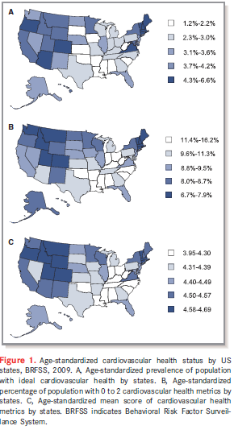
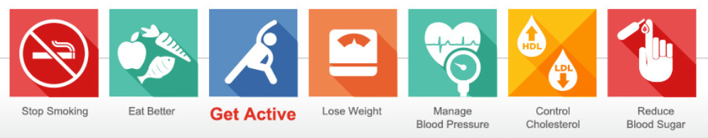

Cardiovascular Health - BRFSS
Hypertension
High cholesterol
Glucose
Body mass index (BMI)
Smoking status
Physical activity
Healthy diet
Fang J, Yang Q, Hong Y, Loustalot F. (2012). Status of cardiovascular health among adult Americans in the 50 states and the District of Columbia, 2009. Journal of the American Heart Association, 1:e005371 doi: 10.1161/JAHA.112.005371

Slide 7
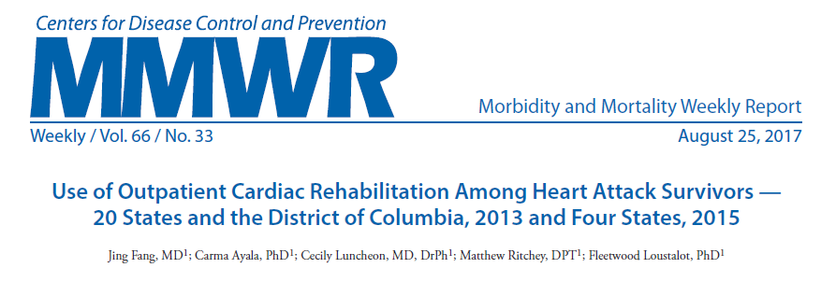
BRFSS Optional Modules
2013 (20 states) and 2015 (four states)
Assessed the use of cardiac rehabilitation among adults following a heart attack
In 2013, only one third of heart attack survivors used cardiac rehabilitation, and its use varied by sex, race/ethnicity, education, insurance status, cardiovascular risk status and by state
The percentage of use of cardiac rehabilitation did not change significantly from 2013 to 2015 among the four states observed during both years
https://www.cdc.gov/mmwr/volumes/66/wr/mm6633a1.htm

Slide 8

Hurricane Irma Deployment

Slide 9
National Health Interview Survey (NHIS)
Nation’s largest in-person household health survey
Since 1957 it has provided data for analyzing health trends and tracking progress toward achieving national health objectives (e.g., Healthy People)
Used for epidemiological and policy analysis
Data linkages are available
National Death Index (NDI) [Mortality Data]
Department of Housing and Urban Development's (HUD)
AHRQ Medical Expenditure Panel Survey (MEPS)
Data on children and adults
http://www.childhealthdata.org/learn/NHIS-Child
https://www.cdc.gov/nchs/nhis/index.htm

Slide 10
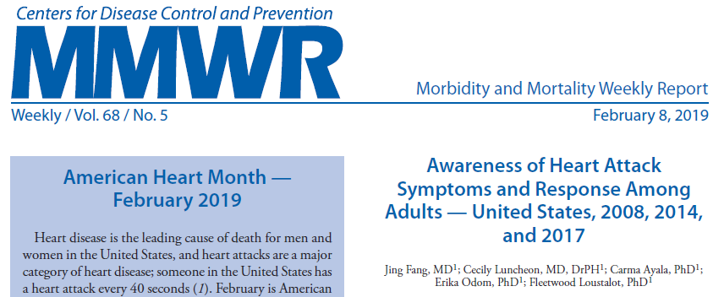
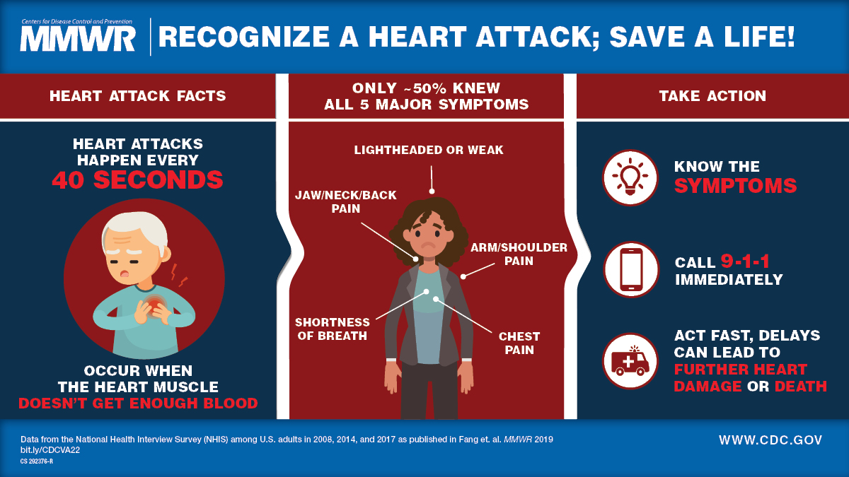
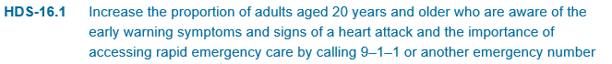
NHIS Examples
https://www.cdc.gov/mmwr/volumes/68/wr/pdfs/mm6805a2-H.pdf

Slide 11
National Health and Nutrition Examination Survey (NHANES)
Nationally representative sample (~5k in 2 year cycles)
Health and nutrition status of U.S. households since the 60s
Most in-depth and logistically complex survey conducted by the National Center for Health Statistics (NCHS)
Data from interviews, physical exams, and laboratory tests
Tutorials are available for review
Data on children and adults
https://www.cdc.gov/nchs/nhanes/index.htm

Slide 12
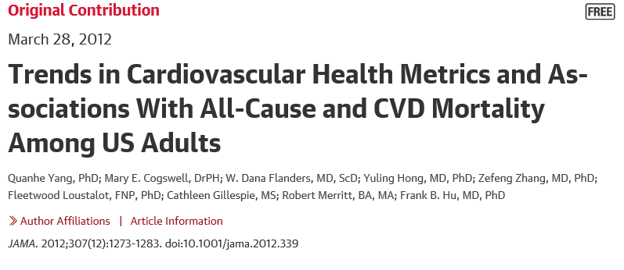
NHANES Example
Interesting aspects of the paper:
Data were linked with the National Death Index, Mortality Files
Multiple cycles of NHANES were used (1988-2010)
Data linkage information: www.cdc.gov/nchs/data-linkage/index.htm
Primary findings:
Meeting a greater number of cardiovascular health metrics was associated with a lower risk of total and CVD mortality, but the prevalence of meeting all 7 cardiovascular health metrics was low.

Slide 13

H1N1 Outbreak Response – US Navy

Slide 14
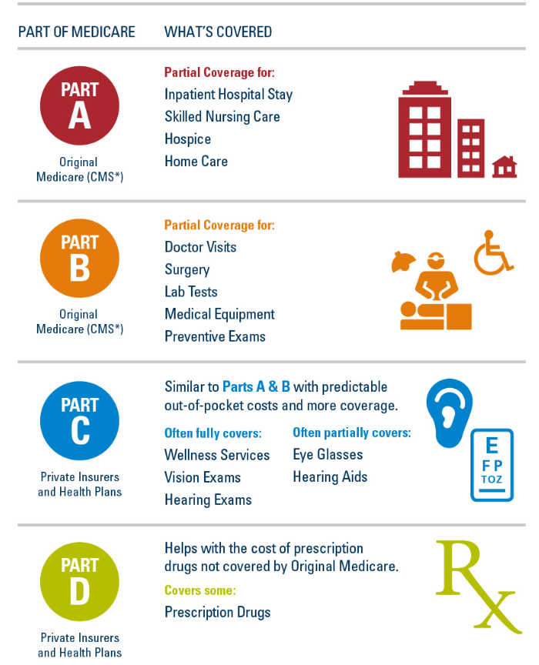
Examples from Other Federal Agencies
Centers for Medicare
and Medicaid Services
Administrative Claims Data
ResDAC
Research Data Assistance
Center
Contractor, data acquisition
Chronic Conditions
Warehouse (CCW)
Online data analysis tool
https://www.ccwdata.org
https://www.bluecrossmn.com/healthy/public/personal/home/shopplans/shop-medicare/what-does-medicare-cover

Slide 15
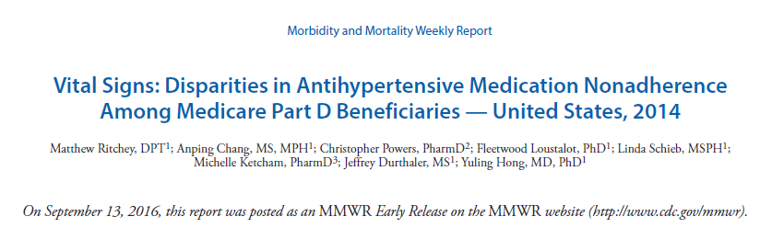
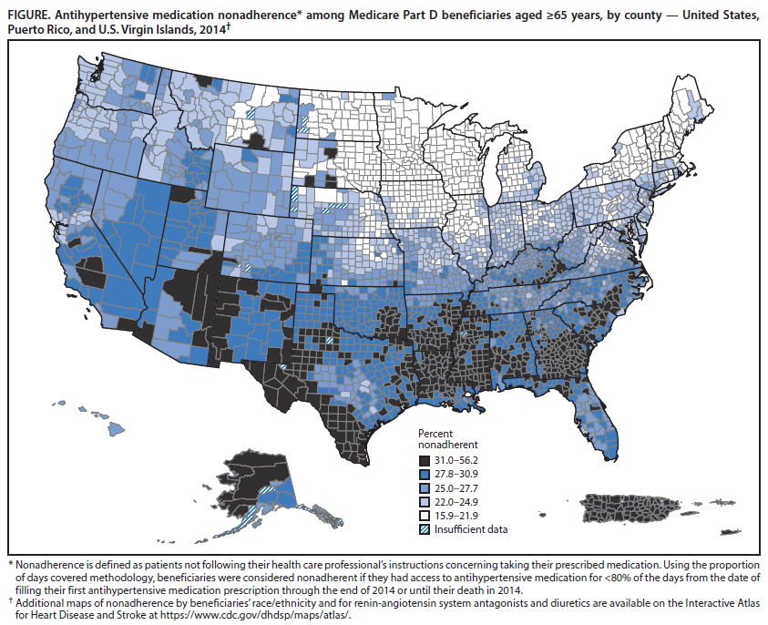

Slide 16

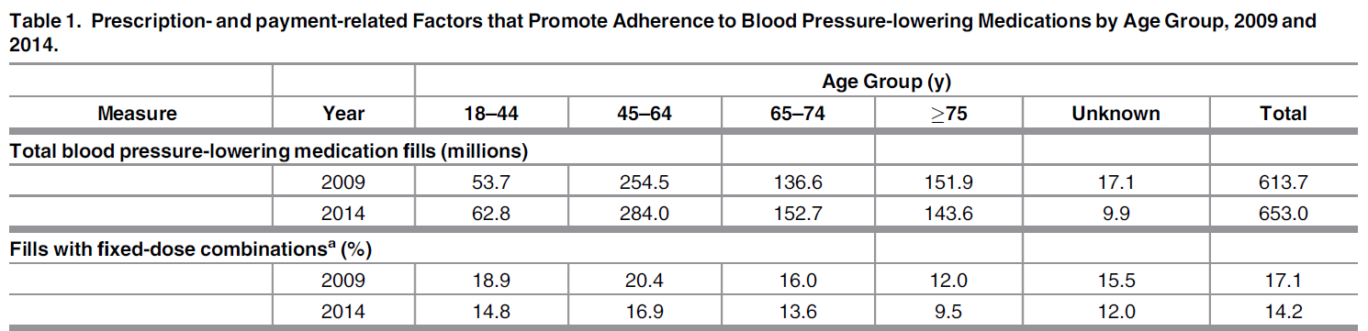
http://journals.plos.org/plosone/article?id=10.1371/journal.pone.0159366

Slide 17
Examples from Other Federal Agencies
Agency for Healthcare Research and Quality (AHRQ)
Healthcare Cost and Utilization Project (HCUP)
Example:
Nationwide Emergency Department Sample (NEDS)
Largest all-payer emergency department (ED) database in the United States. It provides national estimates of hospital-based ED visits
Provides national estimates for approximately 135 million hospital-based ED visits annually
Discharge data for ED visits from 945 hospitals located in 33 States and the District of Columbia, approximating a 20-percent stratified sample of U.S. hospital-based EDs
Cost associated with data acquisition
National data, with State-level data availability
HCUPnet
Free, on-line query system (https://hcupnet.ahrq.gov)
https://www.hcup-us.ahrq.gov/db/nation/neds/nedsdbdocumentation.jsp

Slide 18
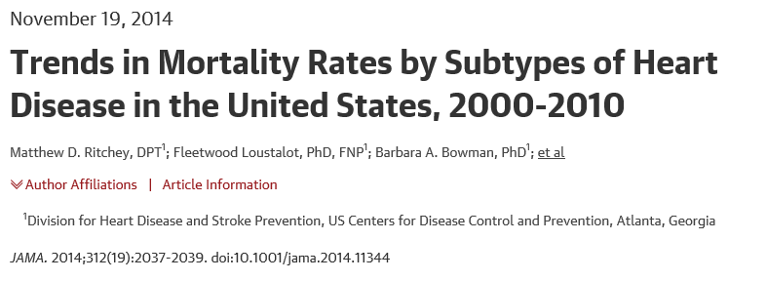
National Vital Statistics System (NVSS)
Vital events – births, deaths, marriages, divorces, and fetal deaths.
CDC Wide-ranging Online Data for Epidemiologic Research (https://wonder.cdc.gov/)

Slide 19
Data supporting national initiatives

Slide 20


What is Healthy People?
Provides a strategic framework for a national agenda that communicates a vision for improving health and achieving health equity
Identifies science-based, measurable objectives with targets to be achieved by the end of the decade
Requires tracking of data-driven outcomes to monitor progress and to motivate, guide, and focus action
Offers model for international, state, and local program planning
Notes:
beacon; a fire or light set up in a high or prominent position as a warning, signal, or celebration.
Healthy People is used in a multitude of ways. Whether you are a health official, Workgroup Coordinator, national membership organization, business, health professional or researcher, there is something in Healthy People for you. Consider Healthy People as a menu from which you can choose a la carte items for your needs. It is used as:
A data tool for measuring program performance,
A framework for program planning and development,
A goal setting and agenda building platform,
A foundation for teaching public health courses,
Benchmarks for comparing State and local data, and
A national agenda for forging partnerships – both traditional and innovative.
In addition, it has served as the model for disease prevention and health promotion plans for other countries, including Egypt, Israel, Japan, Korea, and Uruguay.

Slide 21
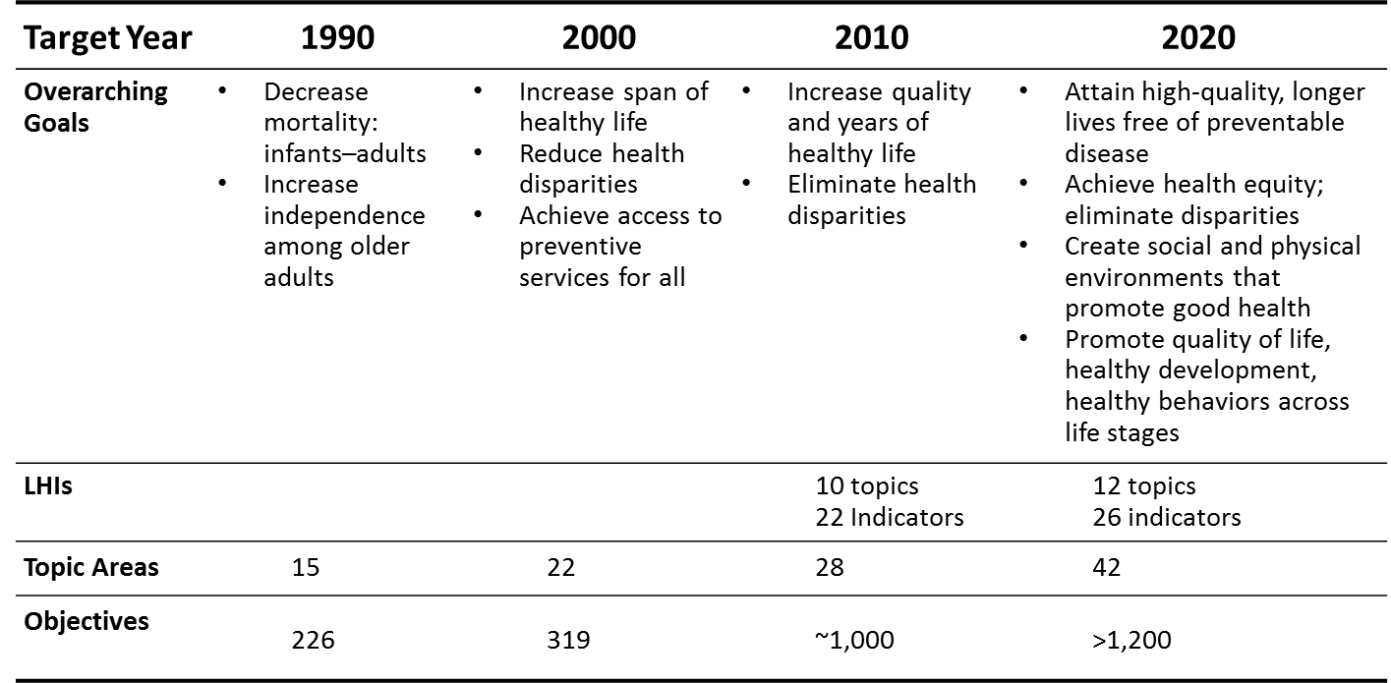
Four Decades of Healthy People
Notes:
HP1990
Topic Areas not organized by a specific framework
Within TAs objectives organized by:
Improved Health Status
Reduced Risk Factors
Increased Public and Professional Awareness
Improved Services and Protection
HP2000
Topic Areas organized by:
Health Promotion, Health Protection
Preventive Services
Surveillance and Data Systems
Within TAs objectives organized by:
Health Status
Risk Reduction
Services and Protection
HP2010/HP2020
Topic Areas alphabetical
Objectives developed/organized by each TA work group

Slide 22
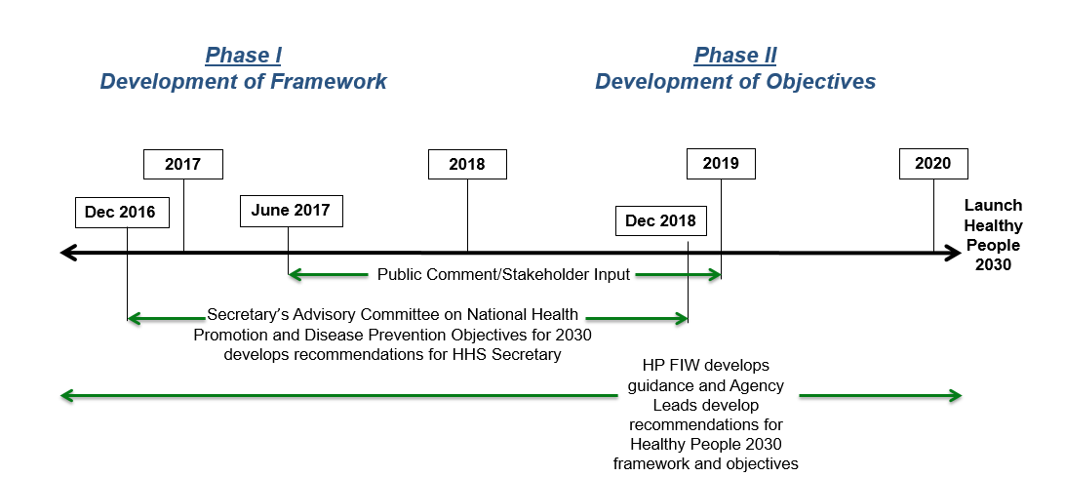
Developing Healthy People 2030
Notes:
Full Committee Meetings: Open to the Public
December 1-2, 2016 (in person)
February 13, 2017 (webinar)
April 27, 2017 (webinar)
June 27, 2017 (webinar)
September 6-7, 2017 (in person)
5 Working Subcommittees
Approaches Subcommittee
Prioritization and Objective Selection Criteria Subcommittee
Stakeholder Engagement and Communications Subcommittee
Social Determinants of Health and Health Equity Subcommittee
Data Subcommittee
Public participation helps shape the framework, objectives, and targets of Healthy People 2030
Two Phases of Public Comment
Phase 1: HP2030 Framework (Vision, Mission, Foundational Principles, Plan of Action, and Overarching Goals)
Phase 2: HP2030 Objectives
Summer
Submit comments online via healthypeople.gov from June 27, 2017 until September 29, 2017
Fall
Look for more information on how to register to submit oral comments at the September 6, 2017 in-person Secretary’s Advisory Committee Meeting
Find Healthy People at the annual APHA meeting session in November 2017

Slide 23
Draft Recommendations for Heart Disease and Stroke Healthy People 2030
Mortality:
↓ Heart Disease
↓ Stroke
Risk Factors:
↑ Cardiovascular health
↑ Aspirin use primary and secondary prevention
↑ Hypertension control
↑ Cholesterol treatment among those eligible
↓ Hypertension prevalence; Mean cholesterol
Improving Systems:
↓ Heart failure hospitalizations
↑ Pre/Post Hospital Management of heart attack/stroke*
*Developmental

Slide 24

Million Hearts® 2022 Aim: Prevent 1 Million Heart Attacks and Strokes in 5 Years
Keeping People Healthy
Optimizing Care
COMMUNITY
Priority Populations
Notes:
To prevent 1 million heart attacks and strokes by 2022, we need to focus on three key priorities:
Keeping people healthy by making changes to the environments in which people live, learn, work, and play to make it easier for people to make healthy choices.
Optimizing care so that those with and at risk for cardiovascular disease receive the services and acquire the skills needed to reduce the likelihood of having a heart attack or stroke.
Improving outcomes for priority populations who suffer worse outcomes of cardiovascular disease and where there is evidence and the opportunity to make a significant impact.

Slide 25
Keeping People Healthy
Goals | Effective Public Health Strategies
Reduce Sodium Intake Target: 20% | Enhance consumers’ options for lower sodium foods Institute healthy food procurement and nutrition policies
Decrease Tobacco Use Target: 20% | Enact smoke-free space policies that include e-cigarettes Use pricing approaches Conduct mass media campaigns
Increase Physical Activity Target: 20% (Reduction of inactivity) | Create or enhance access to places for physical activity Design communities and streets that support physical activity Develop and promote peer support programs
Notes:
To get to the goal of a 20% reduction in sodium intake, smoking, and physical inactivity, we must focus our collective efforts on effective public health strategies.
Strong evidence suggests local food procurement policies can enhance consumer choice for lower sodium foods, while encouraging more producers to offer lower sodium alternatives.
Smoke-free spaces and pricing approaches are effective in driving down tobacco use.
And there is promising evidence that increasing access to places for physical activity, designing communities and streets with physical activity in mind, and peer support–type walking groups can help more individuals increase their physical activity level.

Slide 26
Optimizing Care
Goals | Effective Health Care Strategies
Improve ABCS* Targets: 80% | High Performers Excel in the Use of… Teams—including pharmacists, nurses, community health workers, and cardiac rehab professionals Technology—decision support, patient portals, e- and default referrals, registries, and algorithms to find gaps in care Processes—treatment protocols; daily huddles; ABCS scorecards; proactive outreach; finding patients with undiagnosed high BP, high cholesterol, or tobacco use Patient and Family Supports—training in home blood pressure monitoring; problem-solving in medication adherence; counseling on nutrition, physical activity, tobacco use, risks of particulate matter; referral to community-based physical activity programs and cardiac rehab
Increase Use of Cardiac Rehab Target: 70%
Engage Patients in Heart-healthy Behaviors Targets: TBD
*Aspirin when appropriate, Blood pressure control, Cholesterol management, Smoking cessation
Notes:
Likewise, in order to achieve excellence in clinical care, we need to focus on effective health care strategies.
Evidence has shown that high performers excel in the use of:
Technology, such as electronic health records that include clinical decision support, patient portals, e- and default referrals, registries, and algorithms to find gaps in care.
Teams, including pharmacists, nurses, community health workers, and cardiac rehab teams. The nation needs everyone working at the top of their license and abilities.
Processes that ensure quality care, such as treatment protocols; daily huddles of the medical team; scorecards that show performance status on the ABCS; proactive outreach to patients about their risks, such as uncontrolled high blood pressure; and finding patients with undiagnosed high blood pressure, high cholesterol, or tobacco use.
Patient and family supports, such as training in self-measured blood pressure monitoring; problem-solving in medication adherence; counseling on nutrition, physical activity, tobacco cessation, and avoiding exposure to particulate matter (also known as particle pollution); and systematic referrals to community-based physical activity and cardiac rehab programs.

Slide 27
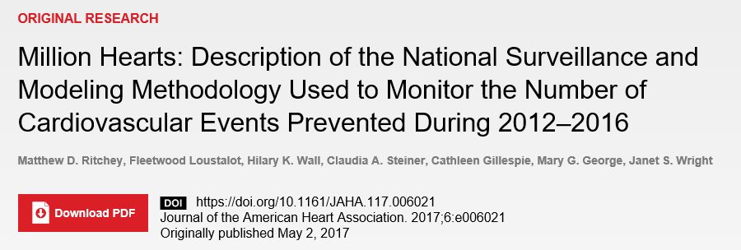

Slide 28
Million Hearts Case Definition Codes* by Event Category and Type
Event Type | Emergency Department Primary ICD-9-CM Codes | Hospitalization Primary ICD-9-CM Codes | Underlying Cause of Death ICD-10 Codes
Acute myocardial infarction | — | 410.X0, 410.X1 | I21
Acute stroke | — | 430, 431, 433.X1, 434.X1, 436 | I60, I61, I62, I63, I64, I67, I69
Symptomatic precursor conditions (e.g., Stable angina pectoris) | 411, 413, 435 | 411, 413, 435 | I20.0, I20.1, I20.8, I20.9, I24, G45.0, G45.1, G45.2, G45.8, G45.9
Other cardiovascular disease conditions (e.g., Heart failure) | 402.X1, 404.X1, 428 | 402.X1, 404.X1, 428 441.02, 441.3, 445 401, 402.X0, 403.X0, 404.X0, 427.5 | I11.0, I13.0, I50 I71.3, I71.4, I70, I73.9 I10, I11.9, I12.9, I13.9, I46
Notes: Exclusions (e.g., presence of end-stage renal disease) are not provided in this slide
Notes:
We identified the following events that occurred among US adults aged 18 and older using these primary diagnosis codes and underlying cause-of-death codes.

Slide 29
Million Hearts Mutually Exclusive Event Calculation Methodology
Not excluded, but assessed further
Excluded
Included in final event
ED visit events
Death events
Hospitalization events
Died in ED
Did not die in ED
Transferred to another hospital
Were not transferred
Admitted to the same hospital
Were not admitted
Died while hospitalized
Did not die while hospitalized
Transferred to another hospital
Were not transferred
Were elective
Were not elective
+
+
Total events
Notes:
We then applied the following exclusion criteria to identify mutually exclusive terminus events that were acute in nature.

Slide 30
Million Hearts Mutually Exclusive Event Calculation Methodology
Not excluded, but assessed further
Excluded
Included in final event
ED visit events
Death events
Hospitalization events
Died in ED
Did not die in ED
Transferred to another hospital
Were not transferred
Admitted to the same hospital
Were not admitted
Died while hospitalized
Did not die while hospitalized
Transferred to another hospital
Were not transferred
Were elective
Were not elective
+
+
Total events
Ritchey, Loustalot, Wall, et al. Million Hearts: Description of the National Surveillance and Modeling Methodology Used to Monitor the Number of Cardiovascular Events Prevented During 2012–2016. J Am Heart Assoc. 2017;6:e006021.
Notes:
For example, for hospitalization events within HCUP,
[click]
we excluded events where the patient died while hospitalized or were transferred, as they should be identified elsewhere within our surveillance. Also,
[click]
we excluded all hospitalizations characterized as elective, because these cases may not be acute in nature and how these cases are managed—for example, within acute care hospitals versus in outpatient surgical centers—might change over time.
[click]
The final hospitalization event count was then included in our overall event totals.

Slide 31
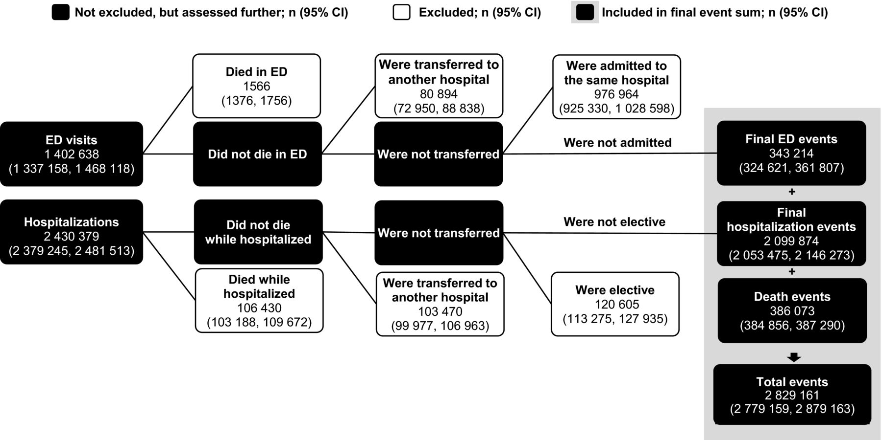
Million Hearts mutually exclusive event calculation methodology applied to the 2013 Nationwide Emergency Department Sample, National Inpatient Sample, and National Vital Statistics System data
Matthew D. Ritchey et al. J Am Heart Assoc 2017;6:e006021
© 2017 Matthew D. Ritchey et al.
Notes:
Million Hearts mutually exclusive event calculation methodology applied to the 2013 Nationwide Emergency Department Sample, National Inpatient Sample, and National Vital Statistics System data to determine the total number of mutually exclusive events. After applying the exclusion criteria, 343 214 ED visits, 2 099 874 hospitalizations, and 386 073 deaths were summed for a total of 2 829 161 mutually exclusive events that occurred in 2013. ED indicates emergency department. Additional details are included in Figure S1.

Slide 32
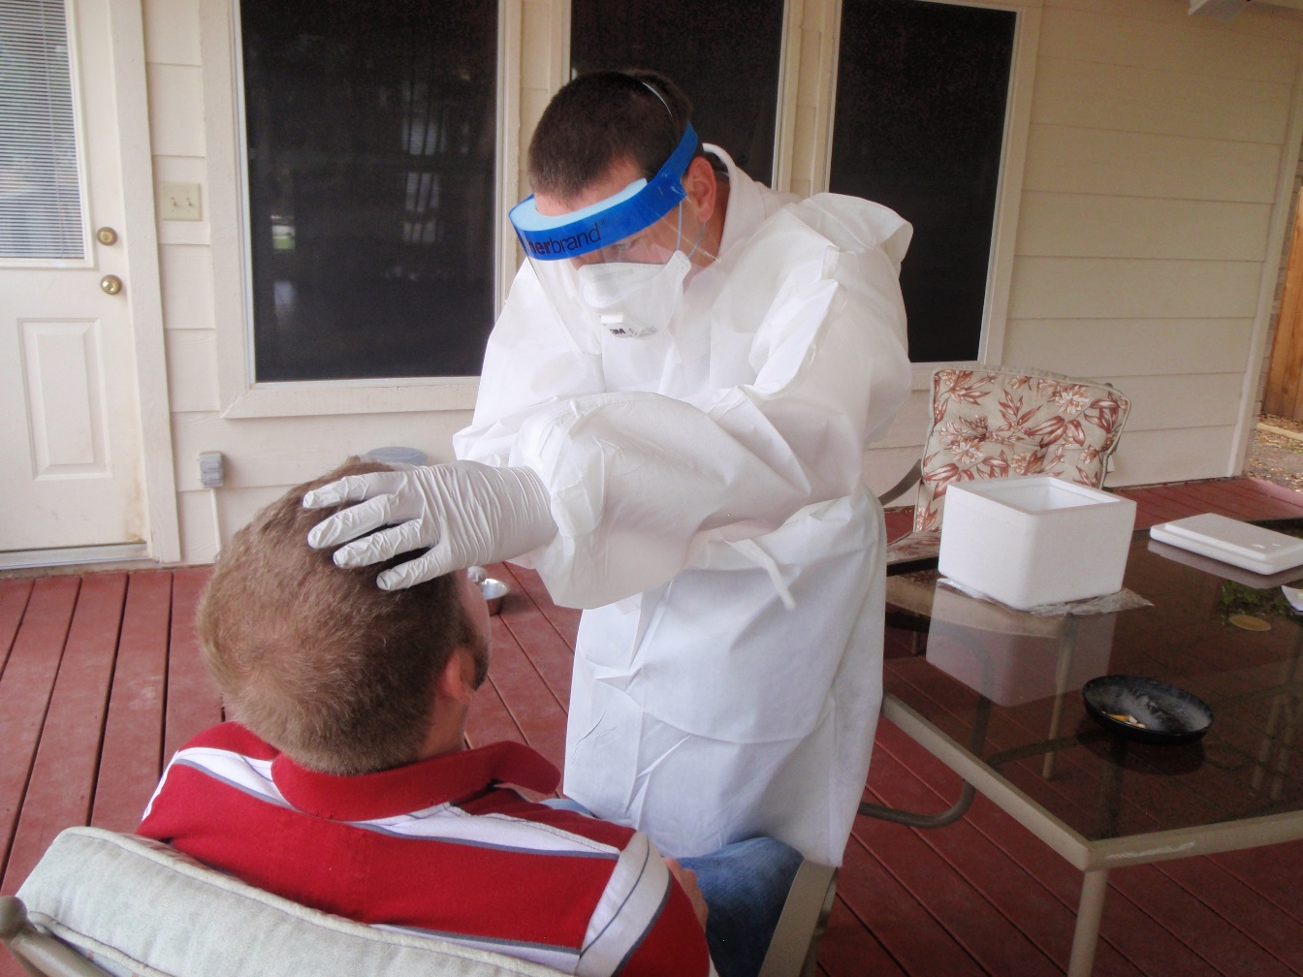
H1N1 Outbreak Response - Texas

Slide 33
Resources

Slide 34

WHO Technical Packages
To defeat the global tobacco epidemic
For cardiovascular disease management in primary health care
For salt reduction
To eliminate industrially-produced trans fat from the global food supply
http://www.who.int/tobacco/mpower/en/
http://www.who.int/cardiovascular_diseases/hearts/en/
http://www.who.int/dietphysicalactivity/publications/shake-salt-habit/en/
http://www.who.int/nutrition/topics/replace-transfat
Notes:
The practical, step-by step modules are supported by an overarching technical document that provides a rationale and framework for this integrated approach to the management of NCDs.

Slide 35

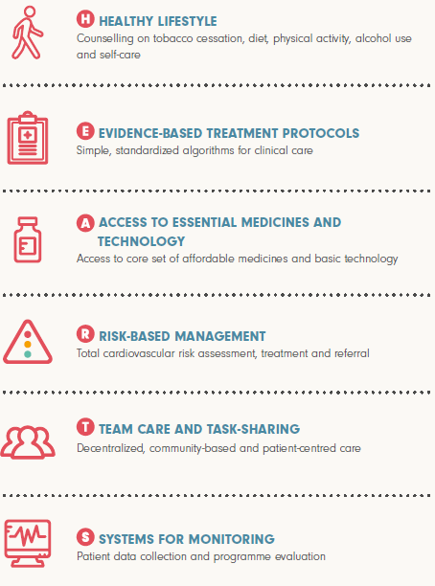

Providing Resources for Country
Implementation
Improved treatment of high blood
pressure
Elimination of artificial trans-fat
Sodium reduction
http://www.who.int/cardiovascular_diseases/global-hearts/en/
https://www.resolvetosavelives.org/
Notes:
Lancet Commission on Hypertension
http://www.thelancet.com/journals/lancet/article/PIIS0140-6736(15)61178-3/abstract

Slide 36
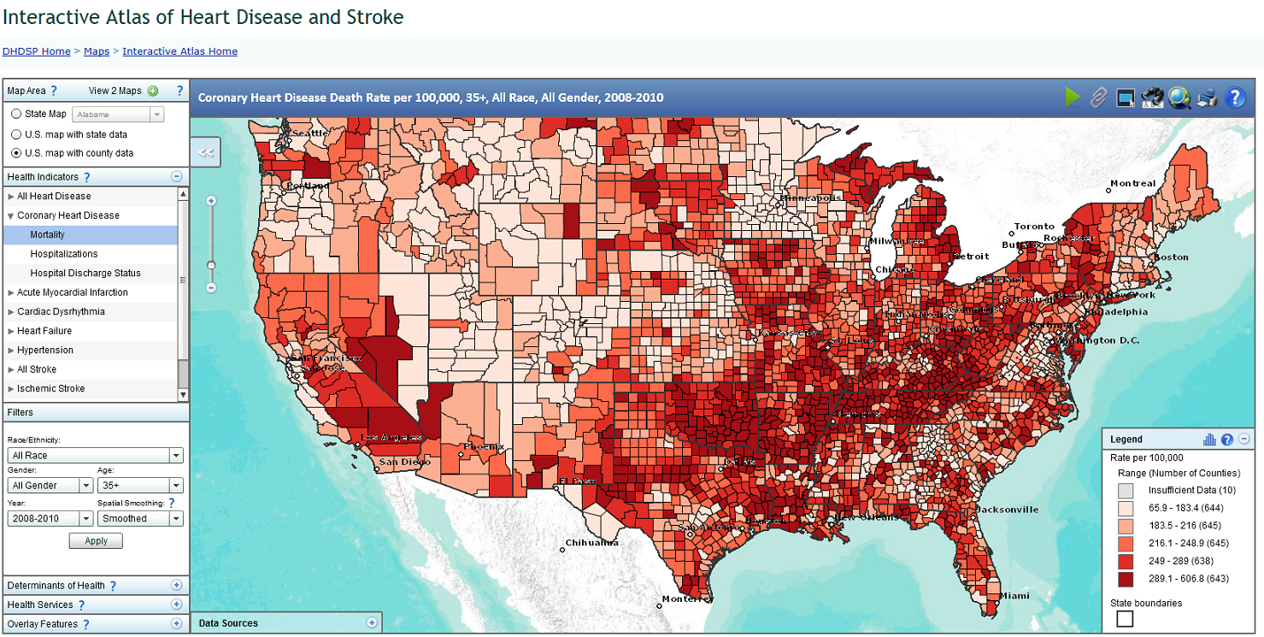
Interactive Atlas of Heart Disease and Stroke
http://nccd.cdc.gov/DHDSPAtlas/

Slide 37
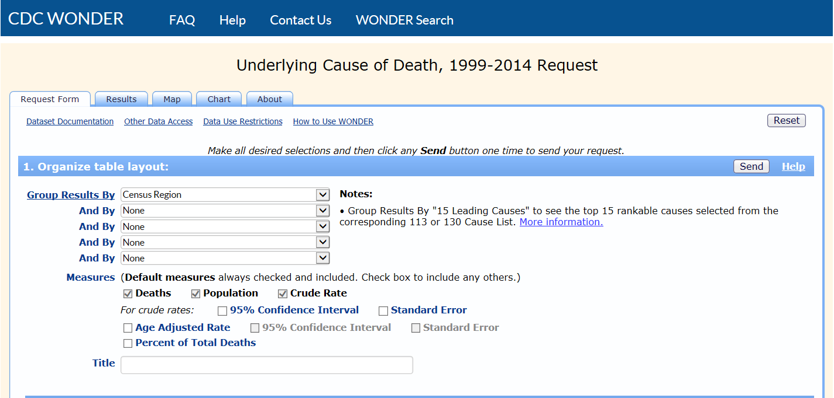
CDC WONDER Wide-ranging OnLine Data for Epidemiologic Research

Slide 38
Free Data Access
Healthcare Cost and Utilization Project; HCUPnet
Hospital utilization, access, charges, quality, and outcomes
https://hcupnet.ahrq.gov
Behavioral Risk Factor Surveillance System (BRFSS)
All 50 states as well as the District of Columbia and 3 U.S. territories
https://www.cdc.gov/brfss/brfssprevalence
500 Cities: Local Data for Better Health
provides city- and census tract-level small area estimates for chronic disease risk factors, health outcomes, and clinical preventive service use for the largest 500 cities in the United States
https://www.cdc.gov/500cities
County Health Rankings & Roadmaps
Annual snapshot of vital health factors at the county-level
http://www.countyhealthrankings.org/

Slide 39
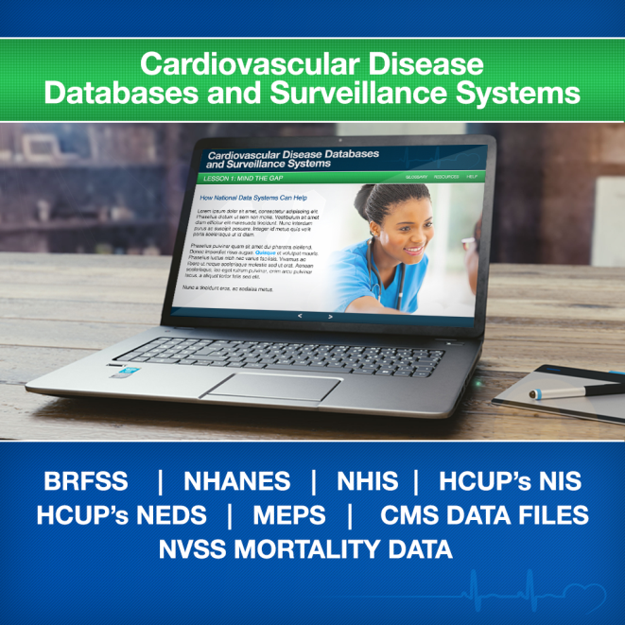
Training Modules for Cardiovascular Surveillance Data
Modules overviewing primary cardiovascular disease surveillance systems
To be available for:
Community
Clinical
Administrative
Links to training modules,
online data tools and other resources
Under-development

Slide 40
Summary
Numerous datasets are available for public use
Numerous resources are available to support the description of the burden of disease and evidenced-based interventions to address the conditions
Short-term and long-term opportunities are available at CDC for training

Slide 41
Thank you
CDC Public Health Training Fellowships
www.cdc.gov/fellowships/
National Center for Chronic Disease Prevention and Health Promotion
Division for Heart Disease and Stroke Prevention

